Slide 1
Lesson 7 - Pandas Dataframe
Mack 2021

Slide 2
DataFrame
A DataFrame is a data structure that stores and aligns data in a table using rows and columns.
It is essentially a collection of more than one Series.
mammal = pd.Series(["African Elephant", "Bottlenose Dolphin", "Cheetah"])
life_span = pd.Series([70, 25, 14])
 | mammal
0 | African Elephant
1 | Bottlenose Dolphin
2 | Cheetah
 | life_span
0 | 70
1 | 25
2 | 14
Notes:
A DataFrame is a data structure that stores information. It aligns the information into a tabular format complete with columns and rows. A Series only allowed for one column at a time, but a DataFrame can combine Series together to form a data table. Here we have a Series listing 3 mammals. Here is a separate Series listing the life spans of the three mammals.

Slide 3
DataFrame
A DataFrame is a data structure that stores and aligns data in a table using rows and columns.
It is essentially a collection of more than one Series.
mammals = pd.DataFrame({"mammal":["African Elephant", "Bottlenose Dolphin", "Cheetah"],
"life_span": [70, 25, 14]})
 | mammal | life_span
0 | African Elephant | 70
1 | Bottlenose Dolphin | 25
2 | Cheetah | 14
Notes:
A DataFrame can be used to combine the two series into one data table. Let’s take a look at the difference in syntax.

Slide 4
DataFrame
A DataFrame is a data structure that stores and aligns data in a table using rows and columns.
It is essentially a collection of more than one Series.
mammals = pd.DataFrame({"mammal":["African Elephant", "Bottlenose Dolphin", "Cheetah"],
"life_span": [70, 25, 14]})
 | mammal | life_span
0 | African Elephant | 70
1 | Bottlenose Dolphin | 25
2 | Cheetah | 14
Notes:
We use the DataFrame function instead of the Series function. The data still goes within the parenthesis but there is an addition of these curly brackets that will contain a python dictionary.

Slide 5
DataFrame
A DataFrame is a data structure that stores and aligns data in a table using rows and columns.
It is essentially a collection of more than one Series.
mammals = pd.DataFrame({"mammal":["African Elephant", "Bottlenose Dolphin", "Cheetah"],
"life_span": [70, 25, 14]})
 | mammal | life_span
0 | African Elephant | 70
1 | Bottlenose Dolphin | 25
2 | Cheetah | 14
Notes:
The dictionary contains keys - which are the names of the columns. This is new. We weren’t able to easily include column names using a Series.

Slide 6
DataFrame
A DataFrame is a data structure that stores and aligns data in a table using rows and columns.
It is essentially a collection of more than one Series.
mammals = pd.DataFrame({"mammal":["African Elephant", "Bottlenose Dolphin", "Cheetah"],
"life_span": [70, 25, 14]})
 | mammal | life_span
0 | African Elephant | 70
1 | Bottlenose Dolphin | 25
2 | Cheetah | 14
Notes:
The values of each key are the elements in the list, or column. Here, you can see the elements of the first column.

Slide 7
DataFrame
A DataFrame is a data structure that stores and aligns data in a table using rows and columns.
It is essentially a collection of more than one Series.
mammals = pd.DataFrame({"mammal":["African Elephant", "Bottlenose Dolphin", "Cheetah"],
"life_span": [70, 25, 14]})
 | mammal | life_span
0 | African Elephant | 70
1 | Bottlenose Dolphin | 25
2 | Cheetah | 14
Notes:
There must be a comma between the different items in the dictionary...

Slide 8
DataFrame
A DataFrame is a data structure that stores and aligns data in a table using rows and columns.
It is essentially a collection of more than one Series.
mammals = pd.DataFrame({"mammal":["African Elephant", "Bottlenose Dolphin", "Cheetah"],
"life_span": [70, 25, 14]})
 | mammal | life_span
0 | African Elephant | 70
1 | Bottlenose Dolphin | 25
2 | Cheetah | 14
Notes:
And then here is the list that represents the elements in the second column. You can continue this process to add on as many columns as you’d like!

Slide 9
DataFrame Functions
mammals = pd.DataFrame({"mammal": ["African Elephant", "Bottlenose Dolphin", "Cheetah", "Domestic Cat", "Giraffe", "Ground Squirrel", "Horse", "House Mouse", "Human", "Killer Whale", "Lion", "Pig", "Rabbit"],
"life_span": [70, 25, 14, 16, 25, 9, 25, 3, 80, 50, 15, 10, 5],
"hours_of_sleep": [3, 5, 12, 12, 2, 15, 3, 12, 8, 3, 20, 8, 11]})
Notes:
Let’s add a few more elements and another column. This can start to look a bit complicated with all the parentheses, curly brackets and straight brackets. We can split it up a bit to clean it up.

Slide 10
DataFrame Functions
data = {"mammal": ["African Elephant", "Bottlenose Dolphin", "Cheetah", "Domestic Cat", "Giraffe", "Ground Squirrel", "Horse", "House Mouse", "Human", "Killer Whale", "Lion", "Pig", "Rabbit"],
"life_span": [70, 25, 14, 16, 25, 9, 25, 3, 80, 50, 15, 10, 5],
"hours_of_sleep": [3, 5, 12, 12, 2, 15, 3, 12, 8, 3, 20, 8, 11]}
mammals = pd.DataFrame(data)
Notes:
We can store the data in a data variable in curly brackets and then create a DataFrame using this variable in parenthesis.

Slide 11
DataFrame Functions
data = {"mammal": ["African Elephant", "Bottlenose Dolphin", "Cheetah", "Domestic Cat", "Giraffe", "Ground Squirrel", "Horse", "House Mouse", "Human", "Killer Whale", "Lion", "Pig", "Rabbit"],
"life_span": [70, 25, 14, 16, 25, 9, 25, 3, 80, 50, 15, 10, 5],
"hours_of_sleep": [3, 5, 12, 12, 2, 15, 3, 12, 8, 3, 20, 8, 11]}
mammals = pd.DataFrame(data)
Notes:
Here you can see where the data variable is being used.

Slide 12
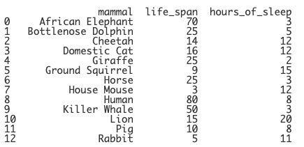
DataFrame Functions
data = {"mammal": ["African Elephant", "Bottlenose Dolphin", "Cheetah", "Domestic Cat", "Giraffe", "Ground Squirrel", "Horse", "House Mouse", "Human", "Killer Whale", "Lion", "Pig", "Rabbit"],
"life_span": [70, 25, 14, 16, 25, 9, 25, 3, 80, 50, 15, 10, 5],
"hours_of_sleep": [3, 5, 12, 12, 2, 15, 3, 12, 8, 3, 20, 8, 11]}
mammals = pd.DataFrame(data)
print(mammals)
Notes:
Printing the DataFrame will display our table. Notice that indices are used here, similar to how they are used in lists, to number the rows in the data. So, what else can we do with a DataFrame? There is a multitude of functions in the pandas library to help you explore your data table. Let’s go over a few.

Slide 13

DataFrame Functions
Command | What does it do?
table.dtypes | Lists the data types used in each column in the DataFrame
print(mammals.dtypes)
Notes:
The dtypes command will list the data types used in each column. This can be important for many reasons. Let’s print out the dtypes for our mammals table. You can see that life_span and hours_of_sleep are stored as integers. This is essential if we’d like to perform mathematical operations with the elements in these columns. It would not work correctly if they were being stored as Strings.

Slide 14
DataFrame Functions
Command | What does it do?
table.shape | Prints the number of rows and columns in the format (rows, columns)
print(mammals.shape)
Notes:
The shape command displays the number of rows and columns in the table. It prints them in a parenthesis with the number of rows displayed first and then the number of columns. Our mammals DataFrame has 13 rows and 3 columns.

Slide 15
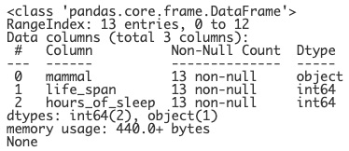
DataFrame Functions
Command | What does it do?
table.info() | Lists the data types used in each column, non-null values, and memory usage info
print(mammals.info())
Notes:
There is also an info function that can be used to display a summary of the DataFrame. Notice that this command includes a parenthesis. This is because there are parameters that can be entered to control what is displayed. For now, we’ll leave this empty so that everything is displayed.

Slide 16
DataFrame Functions
Command | What does it do?
table.info() | Lists the data types used in each column, non-null values, and memory usage info
print(mammals.info())
Notes:
The info function lets us know where the data is pulling from, how many rows there are are (which are listed as entries here).

Slide 17
DataFrame Functions
Command | What does it do?
table.info() | Lists the data types used in each column, non-null values, and memory usage info
print(mammals.info())
Notes:
It also tells us how many columns there are and goes into detail about each column, listing how many non-null elements each columns contains and the data type of each column. Null means empty, so if there are 13 entries and each column has 13 non-null elements, then there are no empty or missing elements in this table.

Slide 18
DataFrame Functions
Command | What does it do?
table.info() | Lists the data types used in each column, non-null values, and memory usage info
print(mammals.info())
Notes:
Lastly, this function sums up how many columns of each data type we have and how much memory is being used to store the DataFrame.

Slide 19
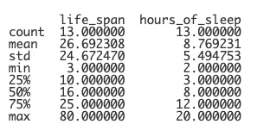
DataFrame Functions
Command | What does it do?
table.describe() | Lists the descriptive statistics for each column.
print(mammals.describe())
Notes:
Another very handy function is the describe function. Again, there are parameters than can be added here which is why this function includes the parenthesis. The describe function lists all the descriptive statistics for each column. The format is a bit messy here, though. There are so many extra zeros in many of the statistics. We can combine this function with the round function in Python to clean this up.

Slide 20
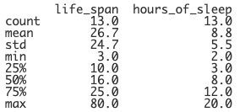
DataFrame Functions
Command | What does it do?
table.describe() | Lists the descriptive statistics for each column.
print(round(mammals.describe(), 1))
Notes:
If we wrap the describe function with the round function, we can tell Python how many decimal places to use. In this case, we’ll use 10. Now, when we print the statistics, they are are rounded to one decimal place.

Slide 21
DataFrame Functions
Command | What does it do?
table.head(num) | Lists the first num rows
table.tail(num) | Lists the last num rows
table[a:b] | Lists the rows from index a to index b, exclusively (not including b).
Notes:
These three functions determine which rows of the table are displayed. The head function will display the first few rows depending on which number is placed in the parenthesis. If there is no number in the parenthesis, the function will display the first five rows as a default. The tail function does the same but for the last rows in the table. You can also choose a specific section of the table to display by using brackets. This will list the rows using the indices of each row from the first number to the last number exclusively. This means that it will NOT include the last number. Let’s take a closer look at this.

Slide 22
Lesson Vocabulary
Term | Definition
data frame | A data structure that stores and aligns data in a table using rows and columns.

Slide 23
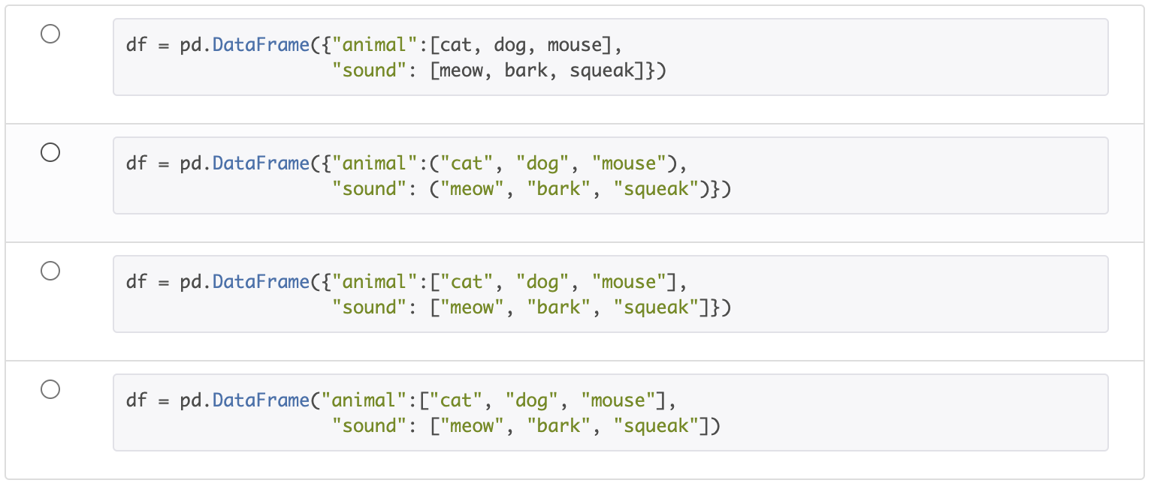
Which option would correctly create a dataframe?
Notes:
🍐 This is a Pear Deck Multiple Choice Slide. Your current options are: A: A, B: B, C: C, D: D,
🍐 To edit the type of question or choices, go back to the "Ask Students a Question" in the Pear Deck sidebar.

Slide 24
Which function will return the number of rows and columns in a dataframe?
Notes:
🍐 This is a Pear Deck Multiple Choice Slide. Your current options are: A: table.describe(), B: table.dtype, C: table.head(), D: table.shape,
🍐 To edit the type of question or choices, go back to the "Ask Students a Question" in the Pear Deck sidebar.

Slide 25
Which function will not select the first 5 rows of the table?
Notes:
🍐 This is a Pear Deck Multiple Choice Slide. Your current options are: A: table.head(), B: table.head(5), C: table[0:5], D: table[0:6],
🍐 To edit the type of question or choices, go back to the "Ask Students a Question" in the Pear Deck sidebar.

